Slide 1


ADICHUNCHANAGIRI UNIVERSITY
BGS INSTITUTE OF TECHNOLOGY
DEPARTMENT OF COMPUTER SCIENCE AND INFORMATION SCIENCE ENGINEERING
University Event,Workshops,Talks, Meeting Management system
Presented by
Jyothi K G (19ISE015)
Monalisa(19CSE044)
Varsha H C (19CSE084)
Nisarga K R (19ISE026)

Slide 2
Analysis
Objectives
By understanding the problem statement thoroughly and considering the manual work done while / before scheduling any meeting/ workshop.
We came up with simple user-friendly idea of Dashboard and its contents of Administration, Committee members and also internal connection to the Canteen to Manage all the things at one place and get activity log of everything and reduce the time and increase the efficiency and quality of every Event.
We need you to create a portal where using this system organizing Bureau/cell will initiate the event by deciding on the following point:
• List of various committees (including members)
• List of involved Committee.
• Role and responsibilities of all concerned members and committees.
• Booking of meeting room/auditorium
• A separate interface to intimate canteen for refreshment/Lunch/dinner arrangements
• Dashboard

Slide 3
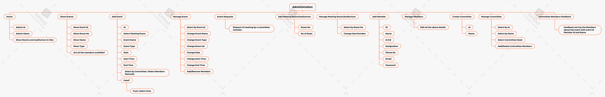
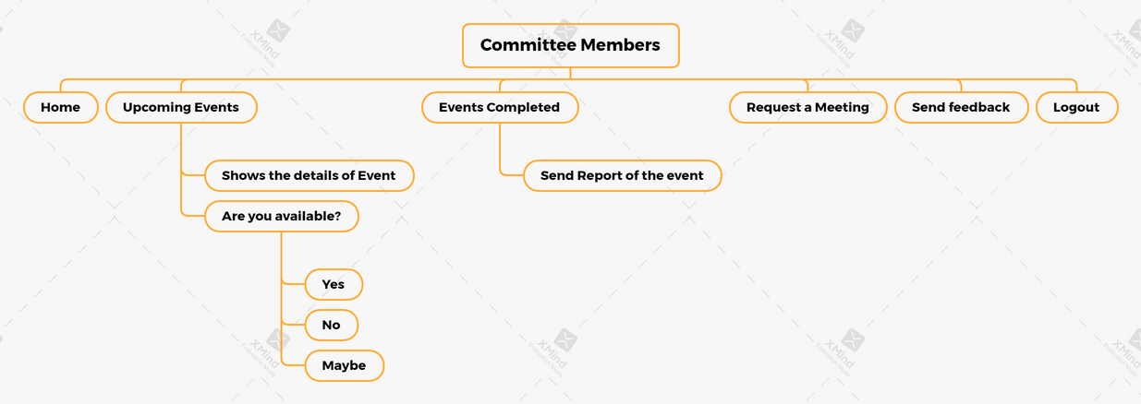
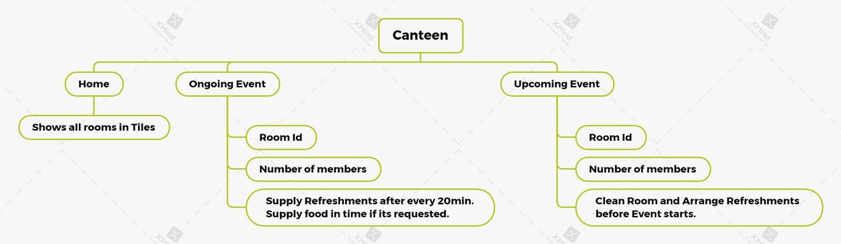
Architecture
Administration ER Diagram
Committe members ER Diagram
Canteen ER Diagram

Slide 4
Methodology
Technology used
We have used the latest web technologies to build this
website for Admin, Committee members and Canteen.
Admin and Canteen logins are hidden from the website for security reasons and Committee members login are publicly available.
In Committee members Dashboard they can request for a meeting, can see their committee members details and further more.
Canteen service will be running with ease.
Automation technology is being used to cut down the work load and give result seamlessly.
Languages used :
HTML
CSS
PHP
Bootstrap
MySQL
Ajax
Software used :
Visual Studio Code
Xxamp Server

Slide 5
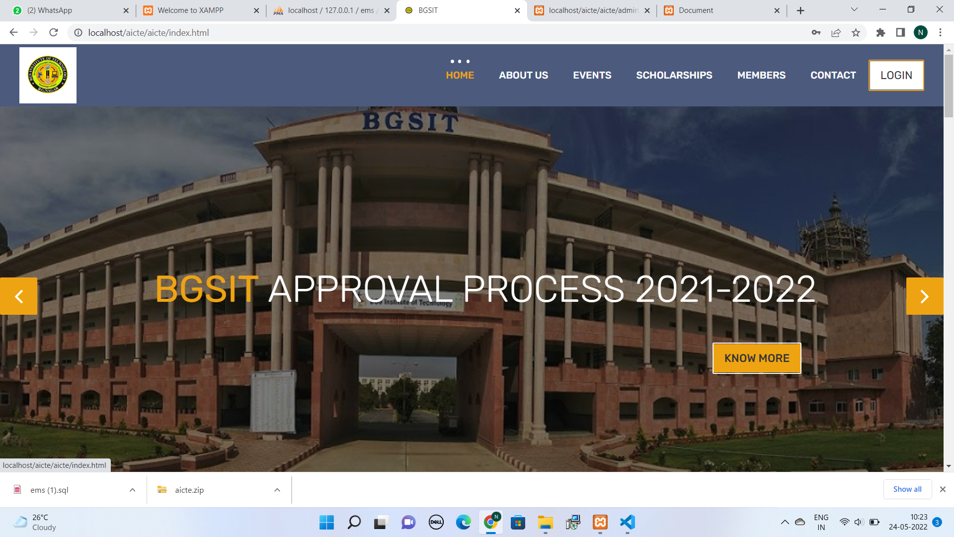
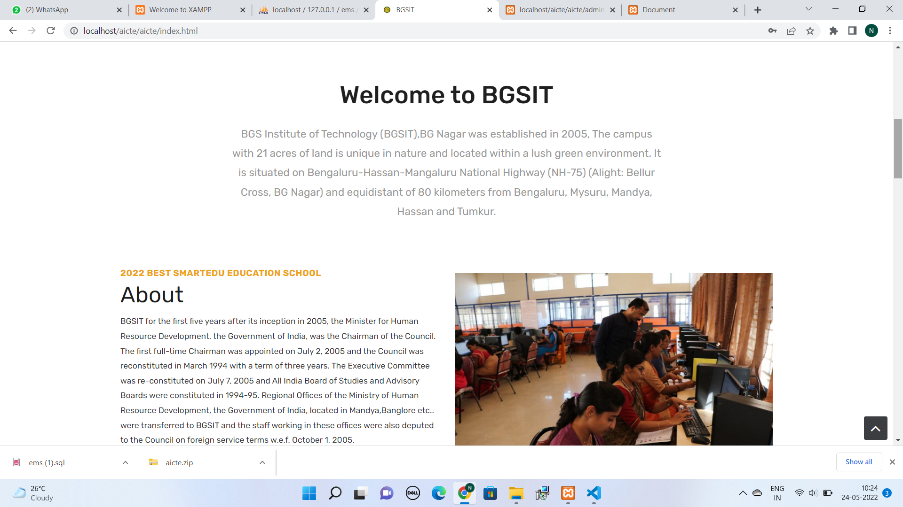

Slide 6
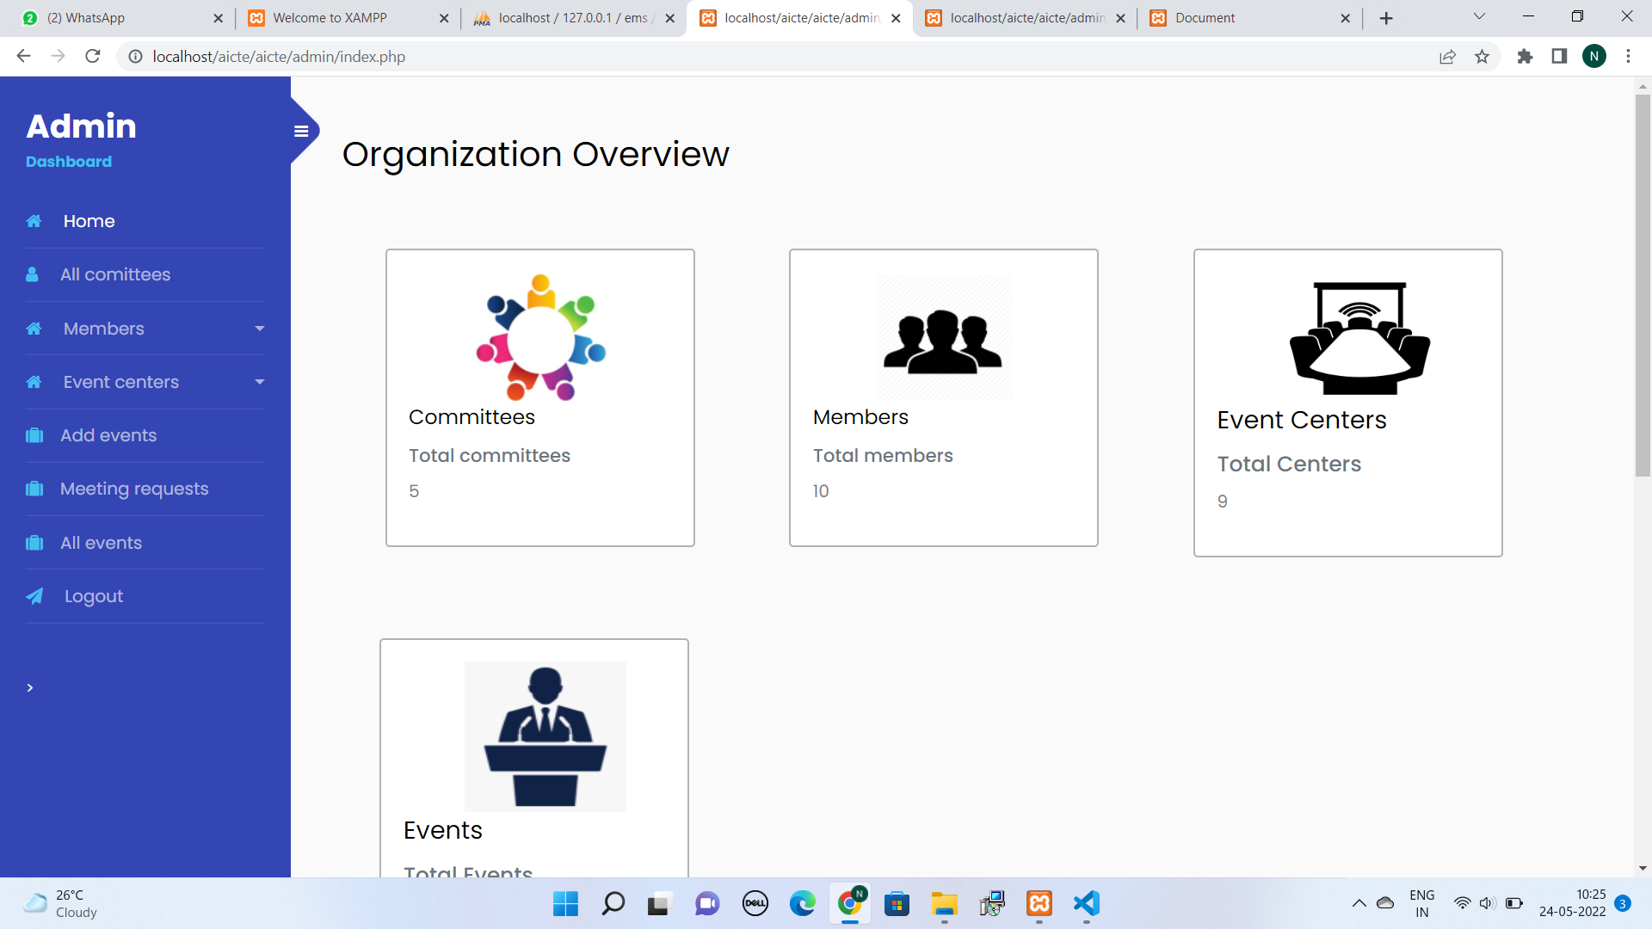
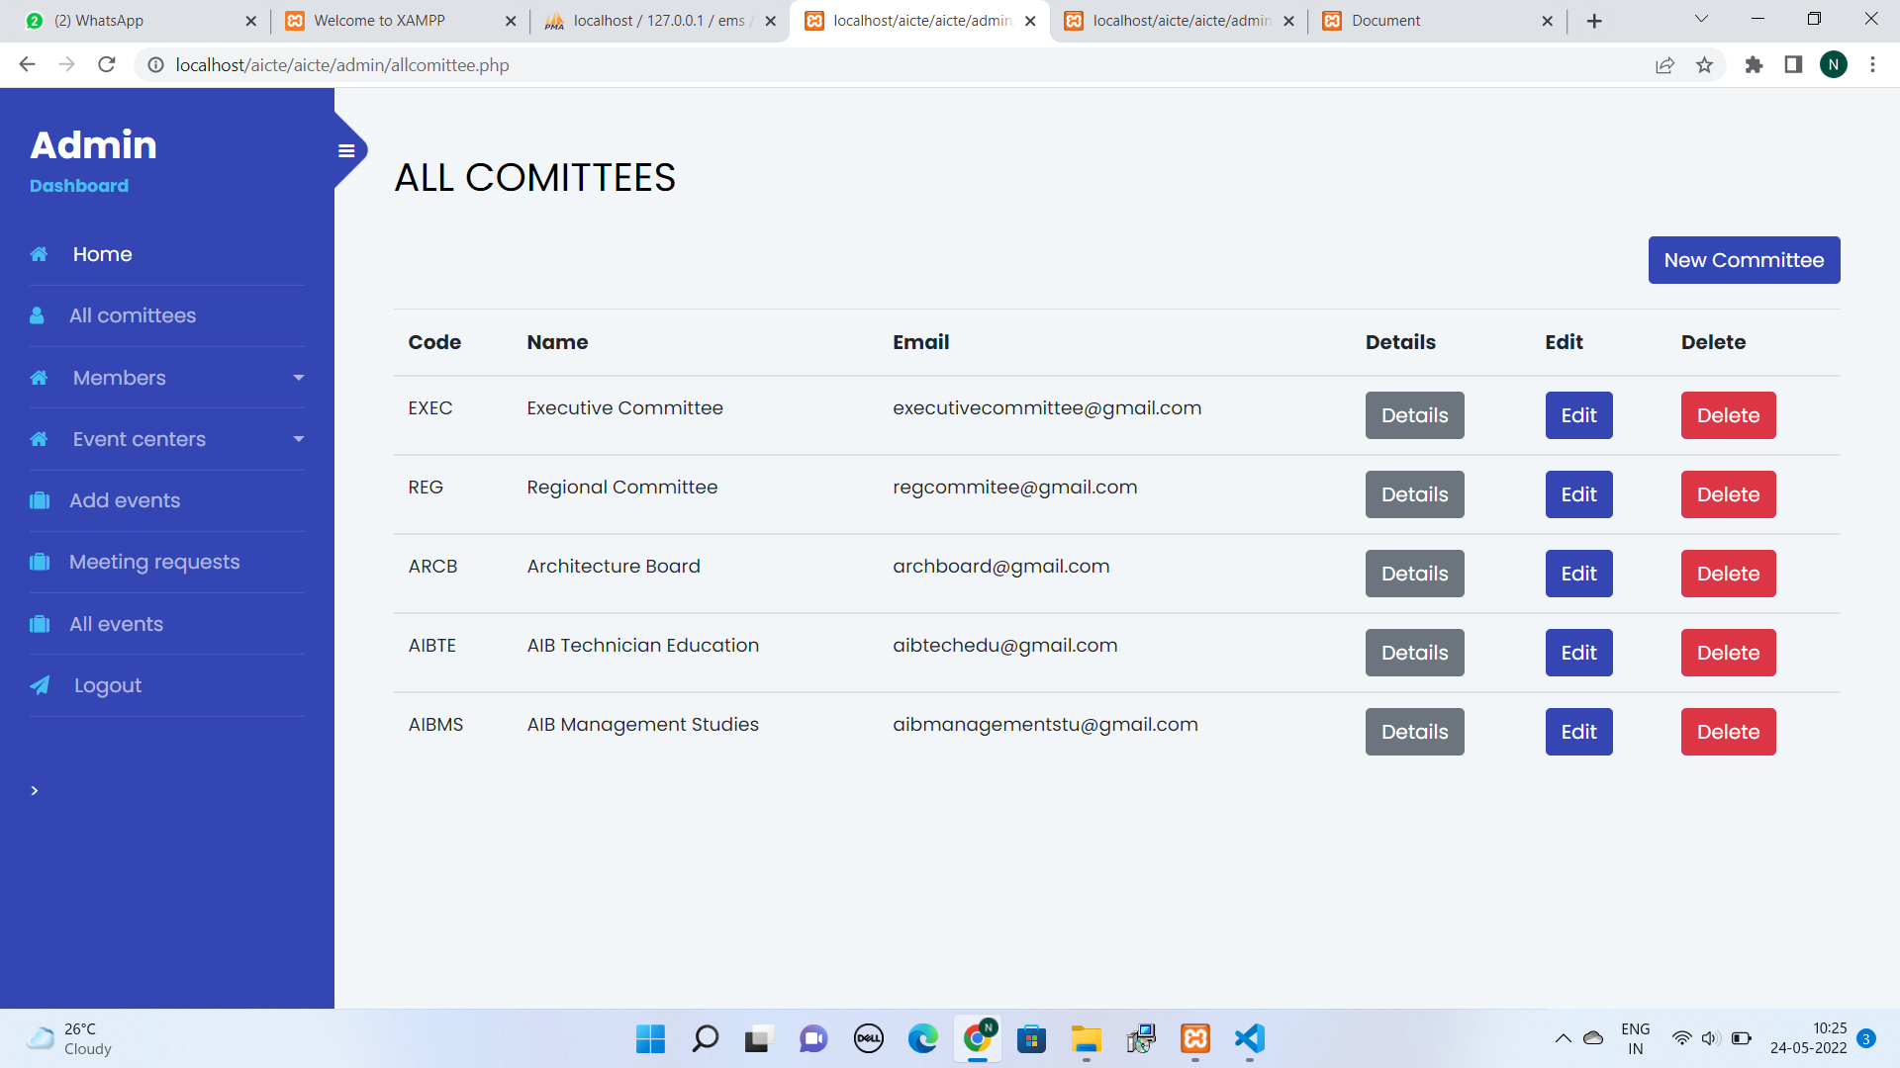

Slide 7
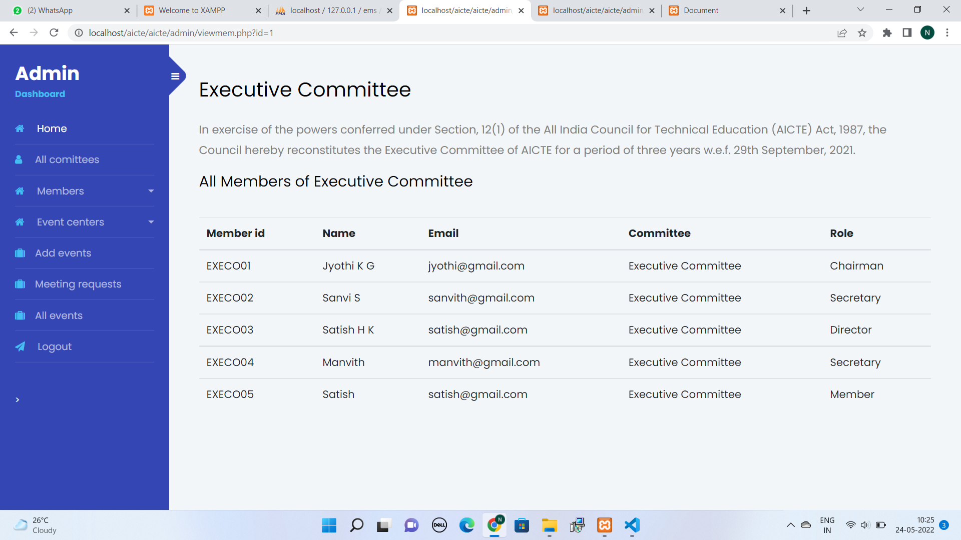
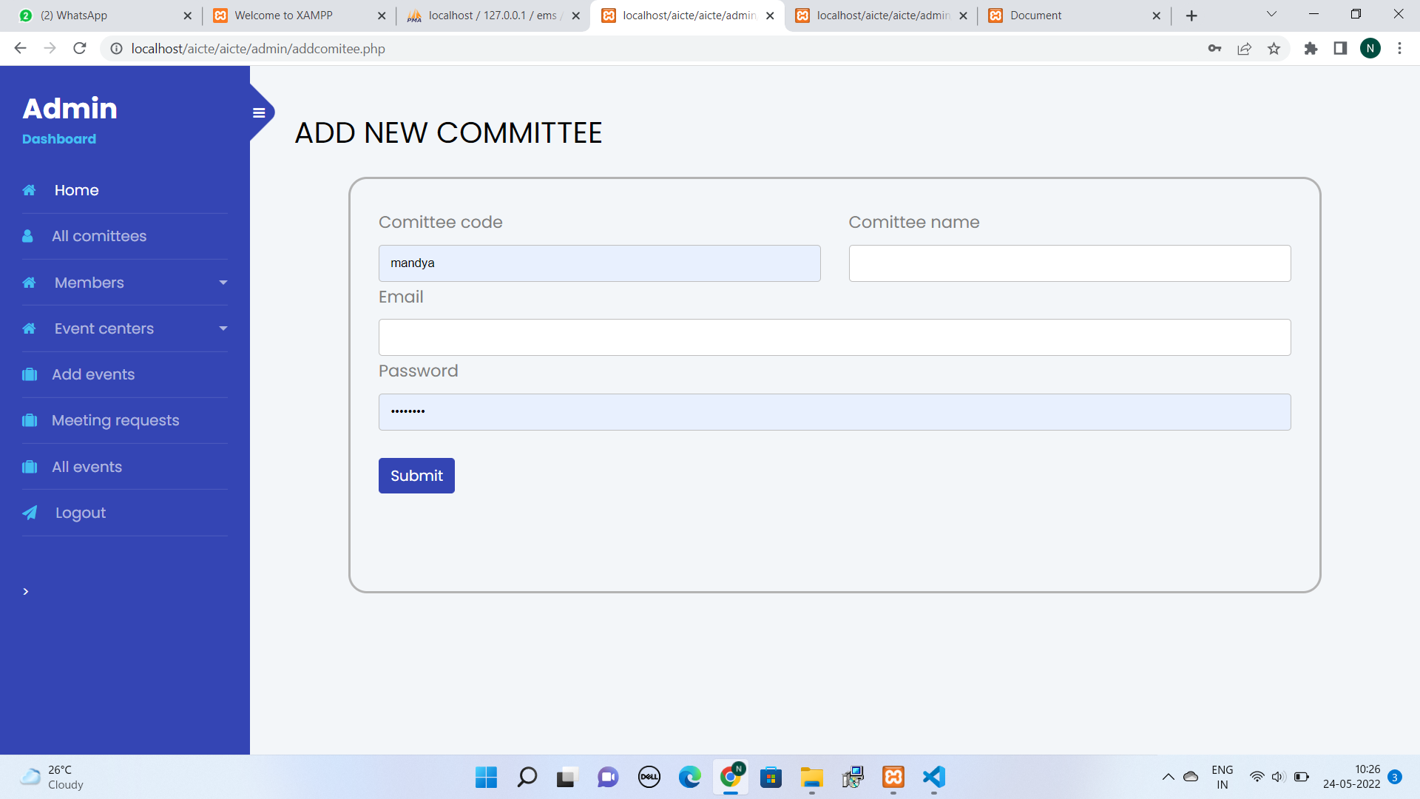

Slide 8
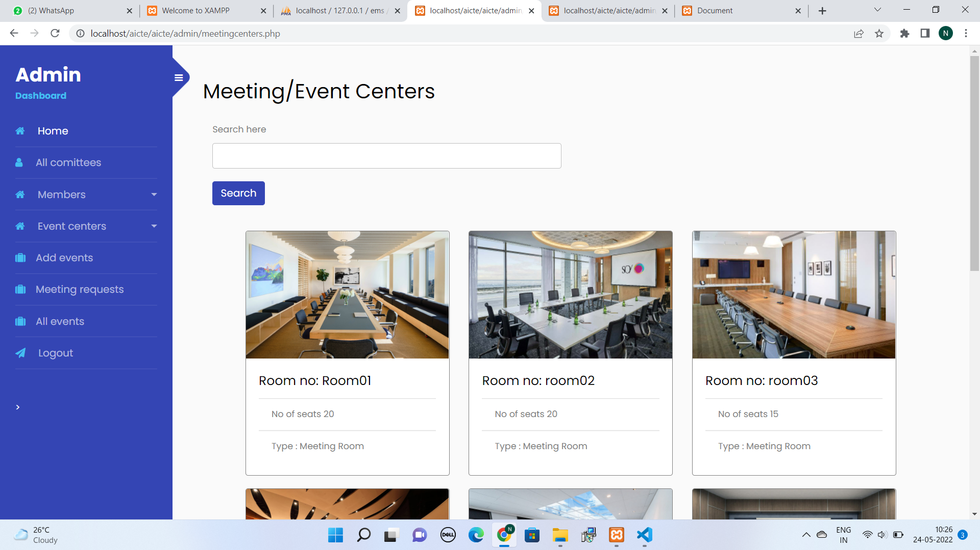
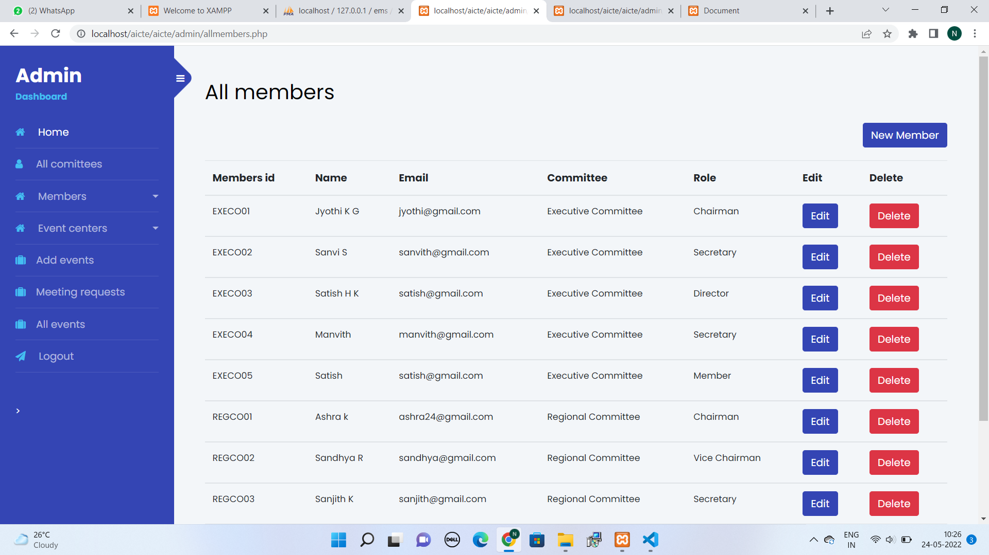

Slide 9
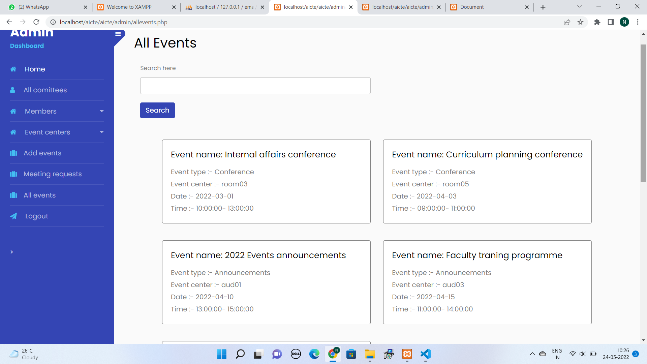

Slide 10
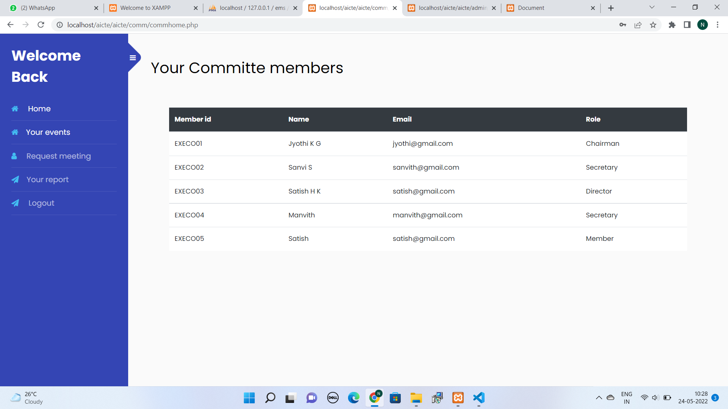
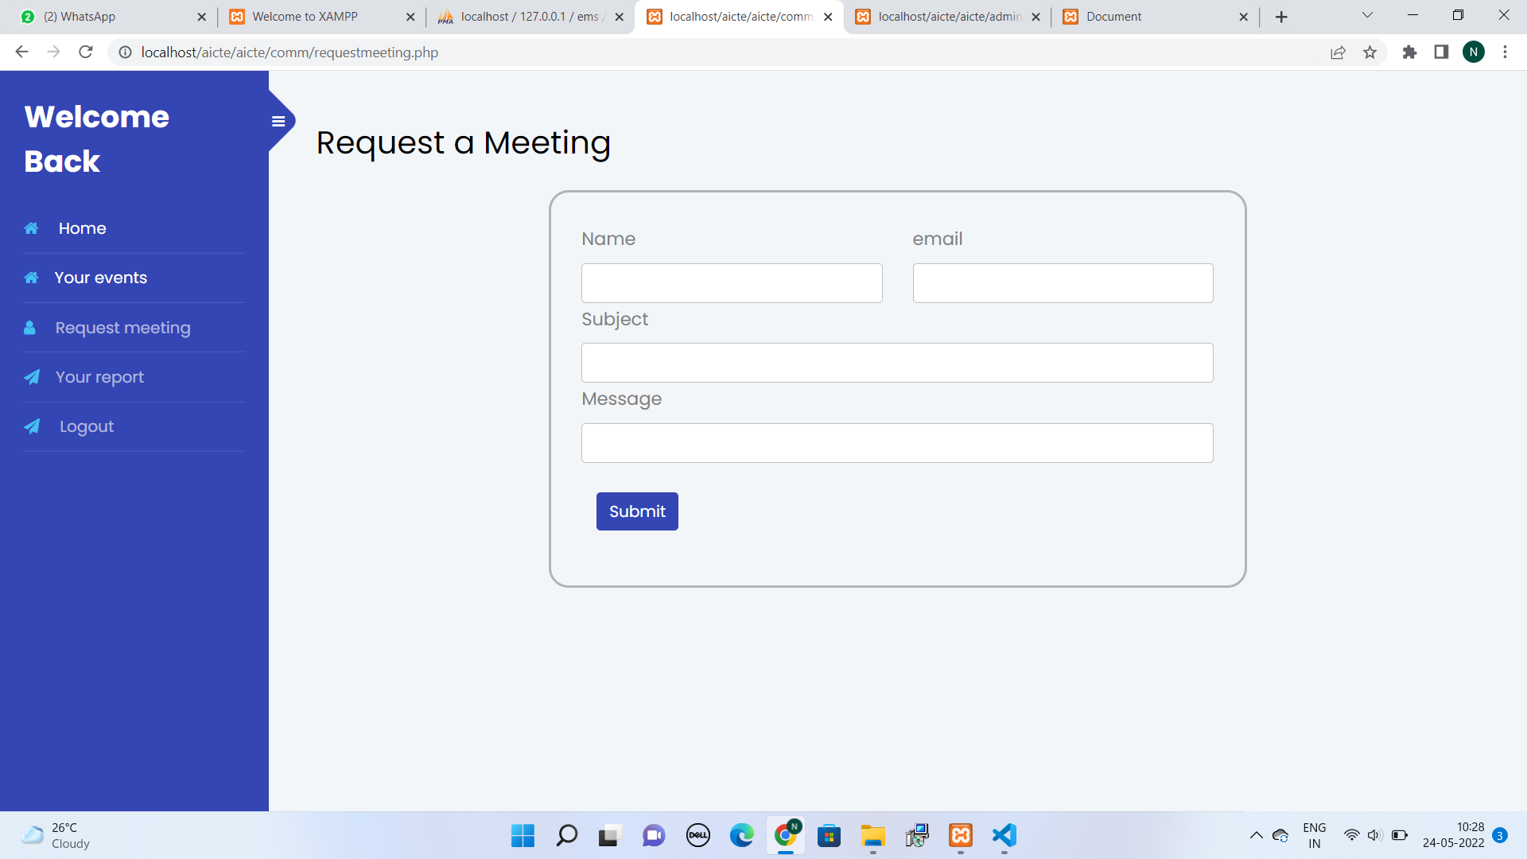

Slide 11
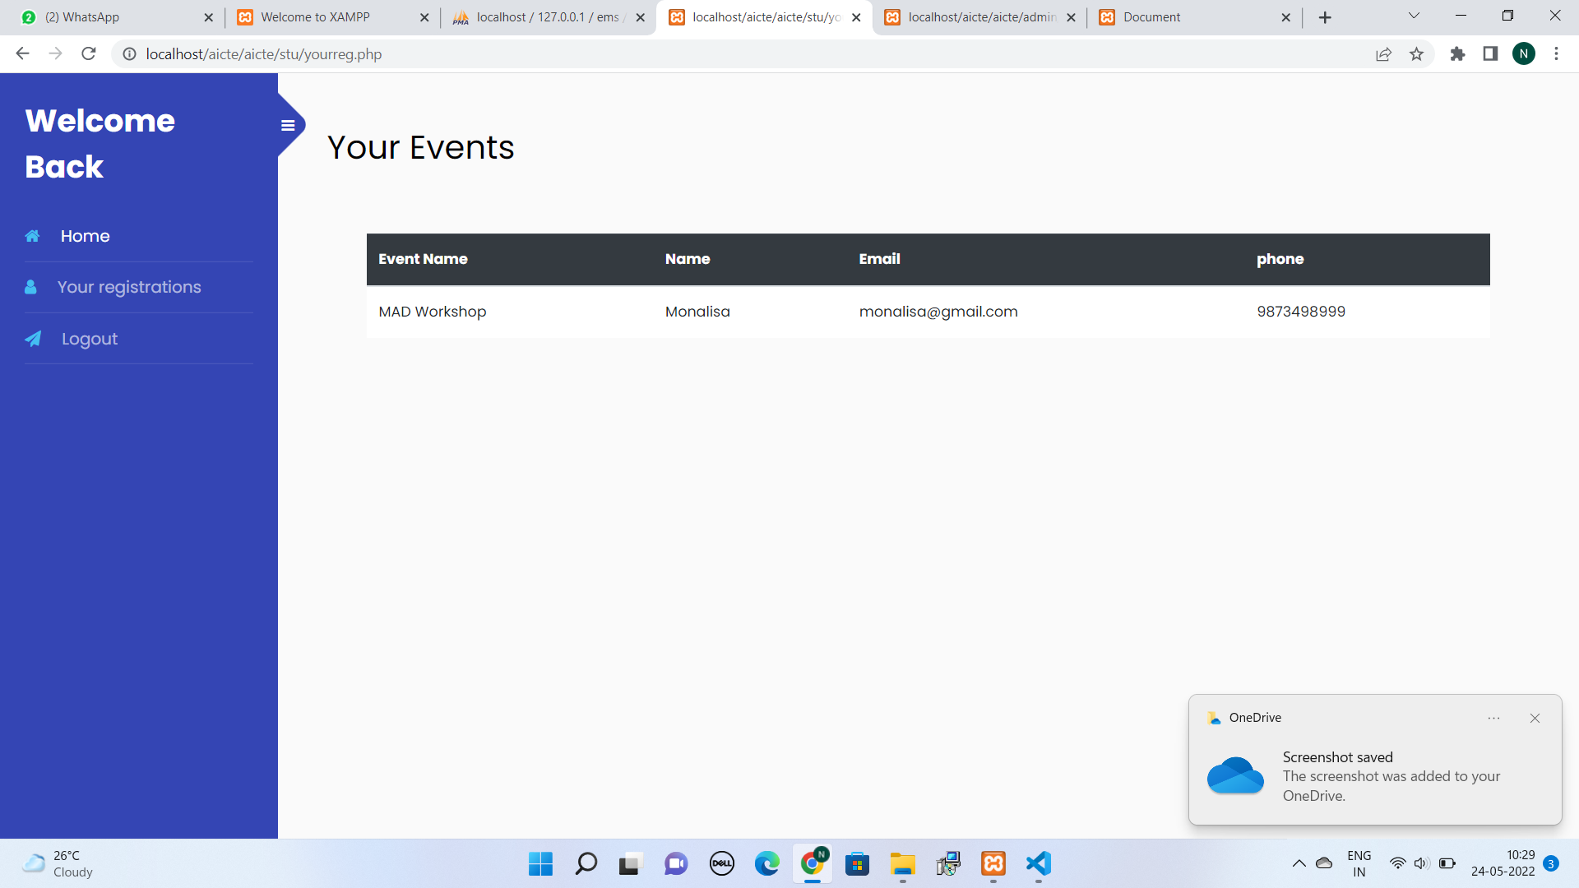
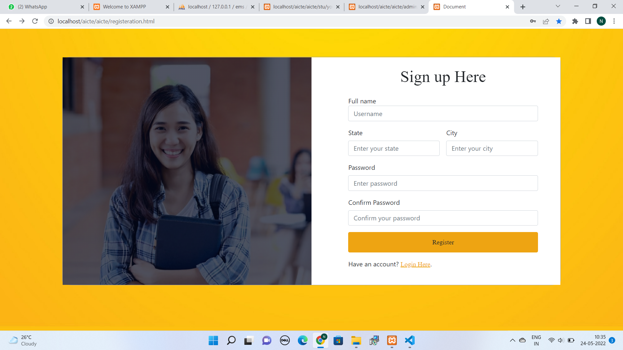

Slide 12
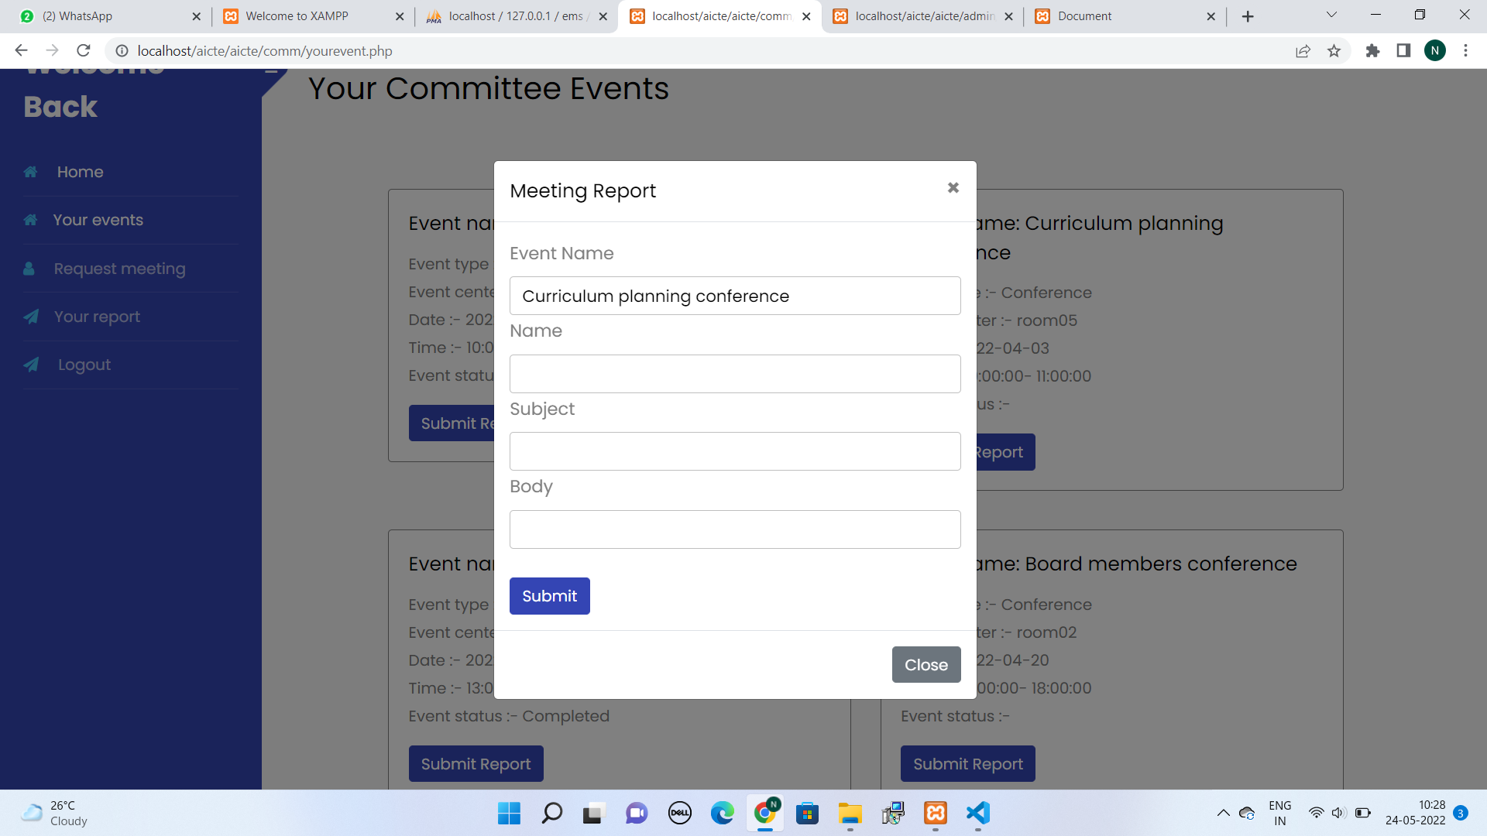
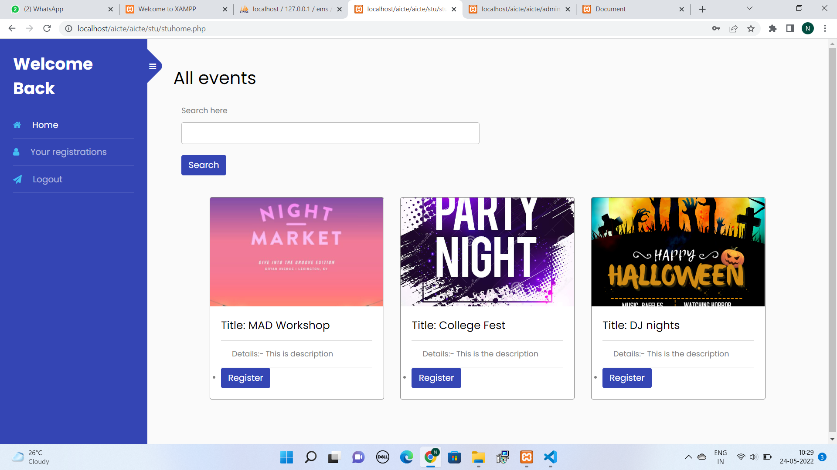

Slide 13
Team Member Details
Team Member 1 Name: Jyothi K G
Branch: B.E. Stream: ISE Year: III
Team Member 2 Name: Monalisa M Gowda
Branch: B.E. Stream: CSE Year: III
Team Member 3 Name: Varsha H C
Branch: B.E. Stream: CSE Year: III
Team Member 4 Name: Nisarga K R
Branch: B.E. Stream: ISE Year: III

